Slide 1
Visualizing Stock Market Trends: Power BI Dashboard Analysis

Slide 2

What is Power BI?
Microsoft Power BI is an interactive data visualization software product developed by Microsoft with a primary focus on business intelligence. It is part of the Microsoft Power Platform.
Microsoft Power BI is used to find insights within an organization’s data. Power BI can help connect disparate data sets, transform and clean the data into a data model and create charts or graphs to provide visuals of the data. All of this can be shared with other Power BI users within the organization.

Slide 3
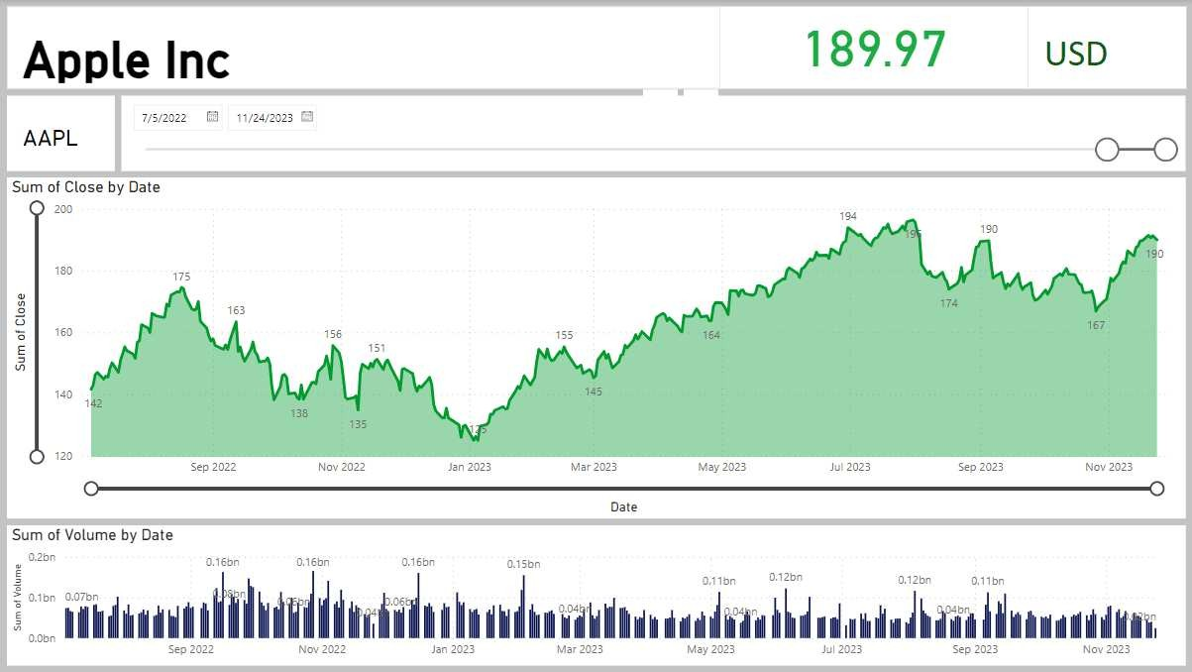
Understanding Stock Market Dashboard
The Stock Market Dashboard project aims to provide a comprehensive andinteractive platform for users to gain insights into the stock market, focusingonaparticular stock’s performance, company overview, and fiscal data. Leveraging the power of Power BI for data visualization and Alpha Vantage API for real-timestockmarket data, the dashboard offers a user-friendly interface that allows dynamicexploration of key financial metrics

Slide 4
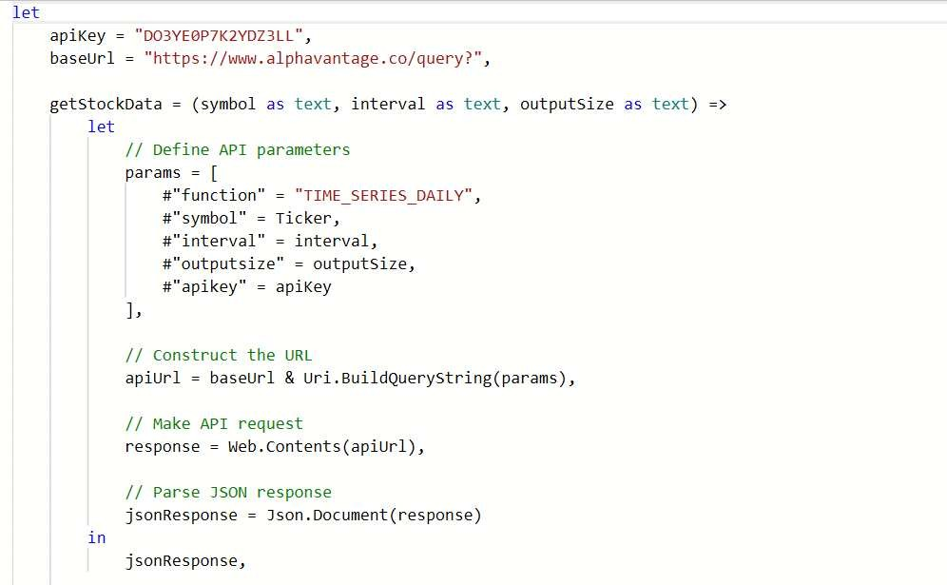
What is M Code?
M can be considered as a query formula language and it can be used in the Power BI Query Editor in order to prepare data before it can be loaded into the Power BI model.
A query language, also known as data query language or database query language (DQL), is a computer language used to make queries in databases and information systems. I

Slide 5
Stock Query M Code
API Key and Base URL:
apiKey = “DO3YE0P7K2YDZ3LL”,
baseUrl = “https://www.alphavantage.co/query?”,
This section defines two variables: apiKey contains the Alpha Vantage API key, and baseUrl contains the base URL for the Alpha Vantage API.
getStockData Function:
codegetStockData = (symbol as text, interval as text, outputSize as text) =>
This is a function named getStockData that takes three parameters (symbol, interval, and outputSize) and returns stock data. let
// Define API parameters params = [
#“function” = “TIME_SERIES_DAILY”,
#“symbol” = Ticker, #“interval” = interval, #“outputsize” = outputSize, #“apikey” = apiKey
],
Inside the function, it defines a list named params that contains various parameters needed for the Alpha Vantage API request, including the function name, stock symbol, time interval, output size, and the API key.

Slide 6
// Constructing the URL
apiUrl = baseUrl & Uri.BuildQueryString(params),
It then constructs the complete API URL by appending the base URL and the encoded query string.
// Making API request
response = Web.Contents(apiUrl),
The function then makes an HTTP request to the constructed API URL using Web.Contents and stores the response in the response variable.
// Parse JSON response
jsonResponse = Json.Document(response)
Finally, it parses the JSON(JavaScript Object Notation) response using Json.Document and returns the resulting JSON document.

Slide 7
3.Mainy Query
// Set the default Ticker value symbolToQuery = “AAPL”,
Sets a default value for the stock symbol to query, in this case, “AAPL” (Apple Inc.).
stockData = getStockData(symbolToQuery, “1d”, “full”),
Calls the getStockData function with the default symbol (“AAPL”), time interval (“1d” for daily), and output size (“full”).
#“Time Series (Daily)” = stockData[#“Time Series (Daily)”], Extracts the “Time Series (Daily)” field from the JSON response.
#“Expanded Value” = Table.ExpandRecordColumn(#“Converted to Table”, “Value”, {“1. open”, “2. high”, “3. low”, “4. close”, “5. volume”}, {“Value.1. open”, “Value.2. high”, “Value.3. low”, “Value.4. close”, “Value.5. volume”}),

Slide 8
Expands the “Value” column, which contains a record, into separate columns for “open,” “high,” “low,” “close,” and “volume.“
#“Renamed Columns” = Table.RenameColumns(#“Expanded Value”,{{“Name”, “Date”},
{“Value.1. open”, “Open”}, {“Value.2. high”, “High”}, {“Value.3. low”, “Low”}, {“Value.4. close”, “Close”}, {“Value.5. volume”, “Volume”}}),
Renames the columns for clarity.
#“Changed Type” = Table.TransformColumnTypes(#“Renamed Columns”,{{“Date”, type date},
{“Open”, type number}, {“High”, type number}, {“Low”, type number}, {“Close”, type number},
{“Volume”, Int64.Type}})
Converts the data types of the columns (e.g., “Date” to type date, “Open” to type number) using Table.TransformColumnTypes.
in
#“Changed Type”
Concludes the main query and specifies the result of the query, which is the transformed and typed table.

Slide 9
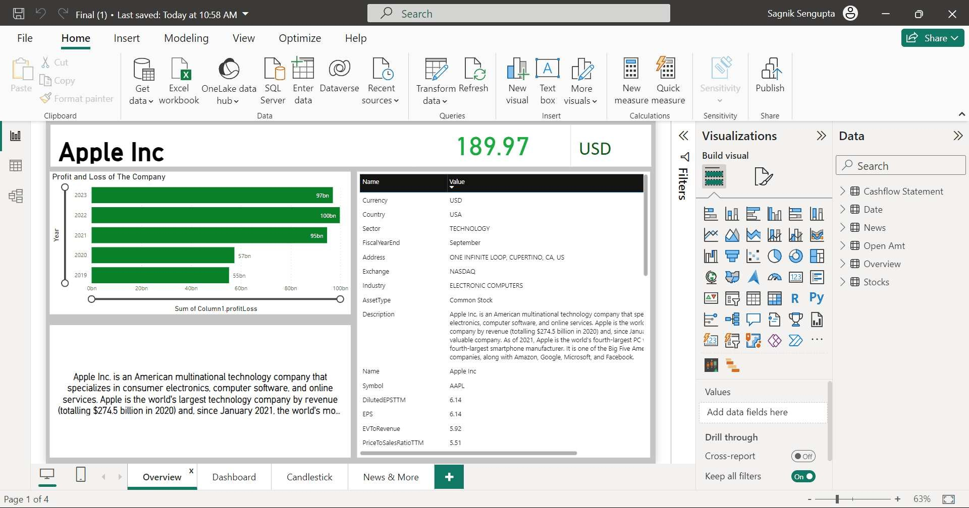
Financial Snapshot and Company Overview
Embark on your analytical journey with a detailed exploration of the company’s financial health. The first page features a meticulously designed Profit and Loss statement, offering a granular breakdown of revenue and expenses. Complementing this financial depth is a comprehensive company overview, detailing essential information such as the company name, symbol, exchange, sector, and other pertinent details, providing users with a nuanced understanding of the business landscape.

Slide 10
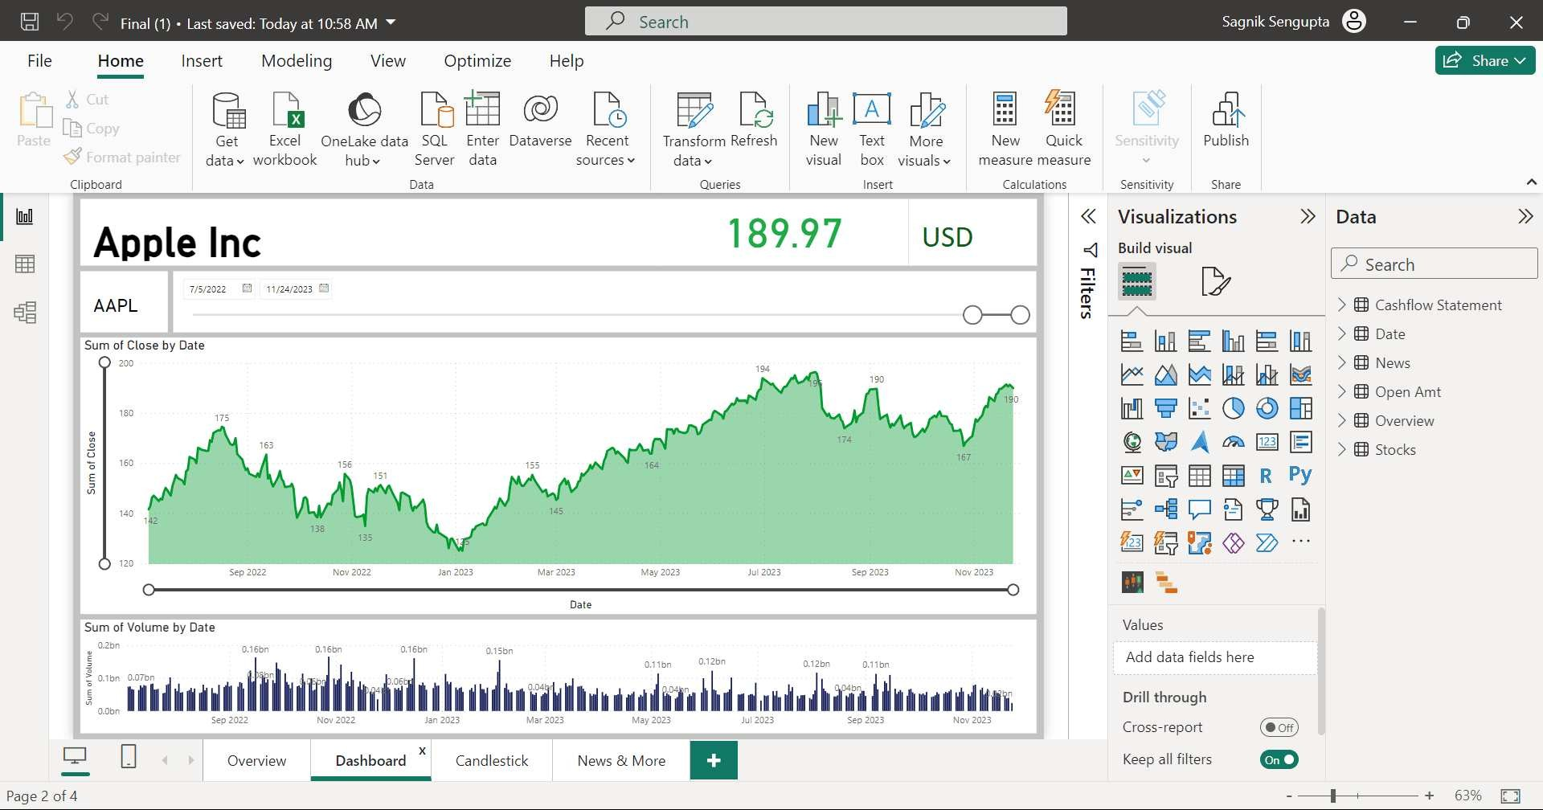
Trend Analysis and Trading Volume Insights
Dive deeper into market trends with the second page, where an aesthetically pleasing area chart visually narrates the story of the sum of close and open prices over time. Below this, a stacked column chart illuminates trading volumes by date, unraveling the intricate dynamics of market participation and liquidity trends. Users can spot patterns, anomalies, and potential turning points with ease, fostering a data-driven approach to decision-making.

Slide 11
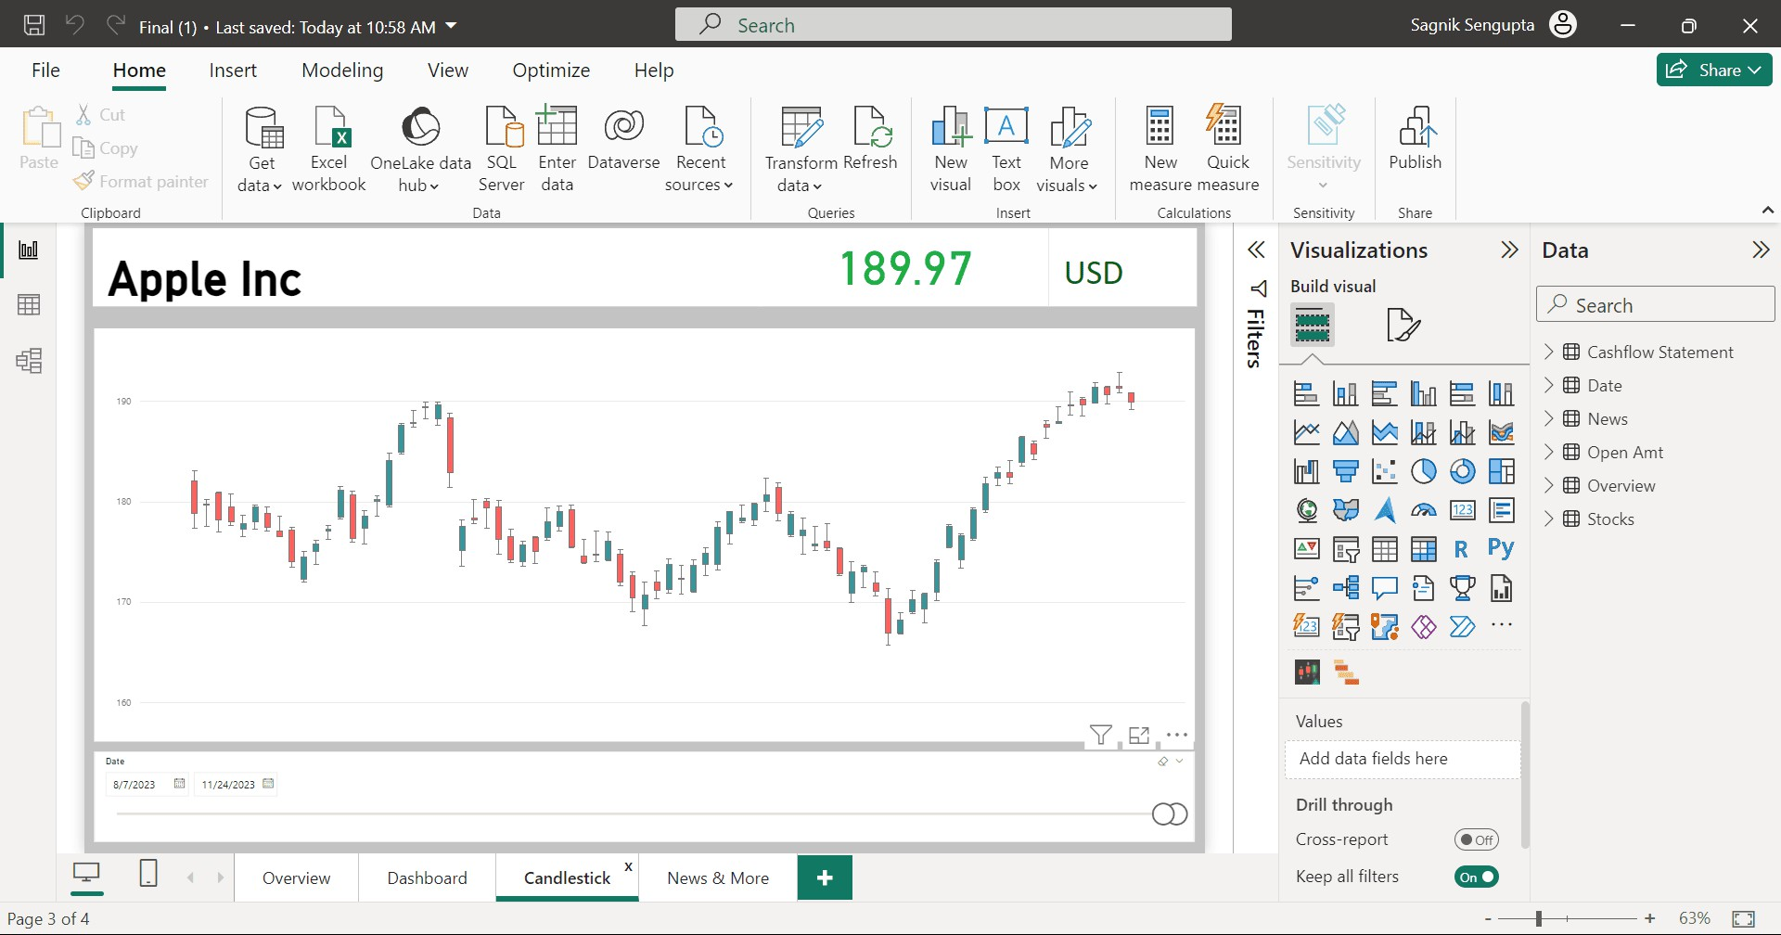
Candlestick Insights for Technical Analysis
The third page is a sanctuary for technical analysis enthusiasts. A detailed candlestick chart takes center stage, illustrating the sum of open, close, high, and low prices over specific time intervals. This visual masterpiece aids in identifying patterns, trends, and potential reversals, empowering users with the tools to make strategic investment decisions based on historical price movements.

Slide 12
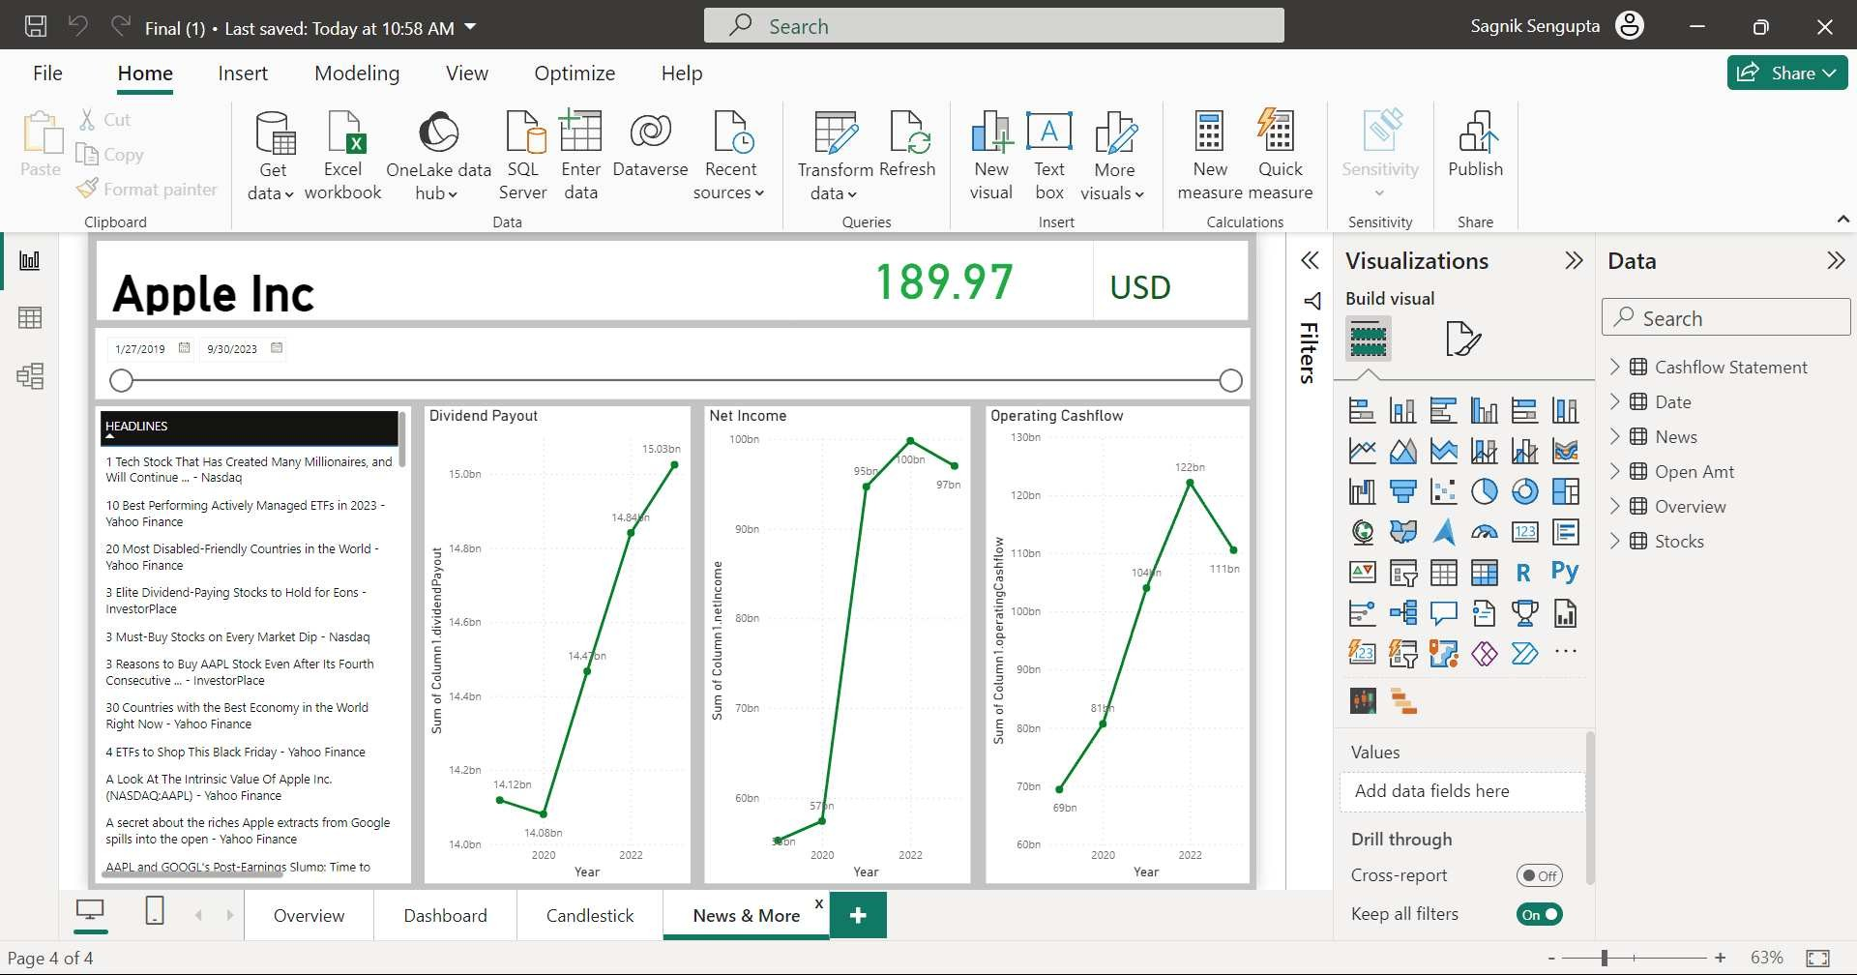
Holistic Financial Metrics and Breaking News
The fourth page seamlessly blends financial metrics with real-time insights. Users can stay abreast of company-specific news, gaining a nuanced understanding of external factors impacting stock performance. Additionally, dynamic line charts unveil historical dividend payouts, net income, and operating cash ﬂow, providing a comprehensive historical perspective for financial evaluation.

Slide 13
Conclusion
The Dynamic Stock Market Analytics Dashboard stands as a testament to the power of data visualization in unraveling the complexities of financial markets. This project, meticulously executed through Power BI, not only equips users with actionable insights but also elevates the user experience through an intuitive and visually engaging interface. As users navigate this analytical masterpiece, they are empowered to navigate the ever-evolving landscape of the stock market with confidence and precision.

Slide 14
Thanks!
BY
Sagnik Sengupta(33401221015) Kinjal Dutta(33401221030) Pratik Banik(33401221032) Shatak Datta(33401221014) Diptanshu Dey(33401221029)
BCA(V Semester) Academic Year (2021-24) Under the guidence of Mr. Mrinal Das

